Slide 1
Wednesday, August 9, 2017
Write In Your Agenda:
Write In Your Monitoring Log:
CW:
“What is a Scientist” tri-fold
HW:
Metric Monster
-final=Mon, 8/14
Sign up for “Remind”
Response to Warm-Up:
List the 3 metric system prefixes in order from largest to smallest!
You will need:
Pencil
Agenda
New Monitoring Log

Slide 2
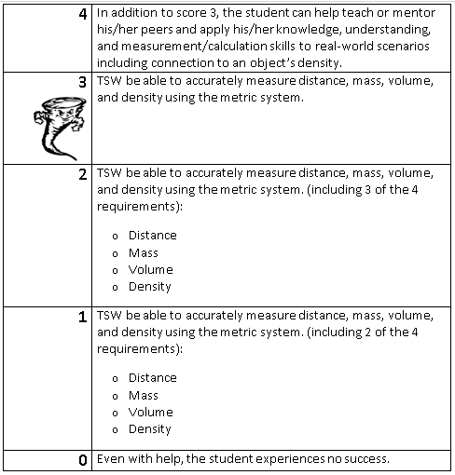
Learning Goal and Scale
TSW be able to describe how the Earth is connected to and affected by other objects in the solar system (including its movement, its relative position to other objects, its seasons, and visible constellations).

